Slide 1
A Practical Introduction to Async
Session by Mitchel Sellers

Slide 2
About The Speaker
Mitchel Sellers
Microsoft C# MVP, DNN MVP
CEO of IowaComputerGurus, Inc.
Contact Info
Twitter: @mitchelsellers
Blog: http://www.mitchelsellers.com
Email: msellers@iowacomputergurus.com

Slide 3
Agenda
What is Async?
Why Async?
But I can already do _______
How it Flows
Demos!

Slide 4
What Is Async? - Terminology
Synchronous – Execute something here and now. Everything will wait for that process to complete.
Asynchronous – Initiate something here and now. However, I will regain control
Async over Sync – The process of using Async to run synchronous processes. (Task.Run for a non async process for example)
Great for offloading
Not so great for scalability (Starting threads etc that are not needed)
Async Keyword – indicator that the method or lambda is async
Await Keyword – applied to a task in an async method to supend the execution of the method until the task completes

Slide 5
Why Async?
Offload Processing <- Great use of Async over Sync
Avoid Tying up the current thread. (User experience, etc.)
Do work on a specific thread (High priority, etc..)
Implementation
Task.Run
Concurrency
Start multiple operations so they may process concurrently
Implementation
Parallel Library Methods, or Task.Run + AwaitAll. (Example later)

Slide 6
Why Async Continued
Scalability
Effectively use resources
Don’t waste resources when there isn’t a need
Implementation
Async I/O Operations
Windows 8 API’s are a great example or the HTTPClient demo later in this presentation

Slide 7
But I can already….
Async, Await & related keywords are dual purpose
New Behavior
Required for implementation of scalability items for resource management
Windows 8 IO Libraries, etc
Composition of Old
Can better compose for readability and maintainability old code
More robust composition as well from the old BackgroundWorker etc
Just another tool in the toolbox!
Think of WCF, ASMX, JSON, REST, etc…

Slide 8
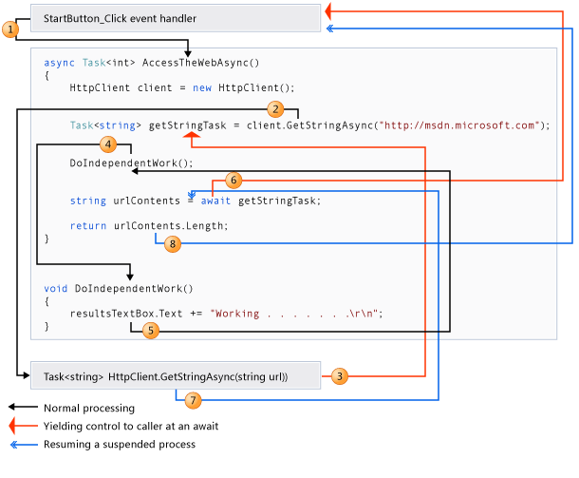
A Walk Through of an Async Method

Slide 9
Design Anti-Patterns
Async Void == BAD!!
Fire and Forget ONLY
Caller is unable to know when method is finished
Caller is unable to catch exceptions
Usage
Event handlers are the exception to the rule
All other places return Task

Slide 10
Being a Good Developer
Library Methods Shouldn’t Lie
Only use the xxxAsync naming convention if you are truly thread-agnostic
Callers can come from other locations
By default await will try to marshal back to the calling thread, this isn’t always needed
ConfigureAwait(continueOnCapturedContext:false)
Usage await mymethod.Configure….

Slide 11
Code Demos!
WPF Sample Application
Will be posted to my blog for download

